Slide 1
Senior Project
Movie Recommendation System
By: Samrajya Thapa, svthapa@go.olemiss.edu
Sponsor: Dr. Yixin Chen, ychen@cs.olemiss.edu

Slide 2
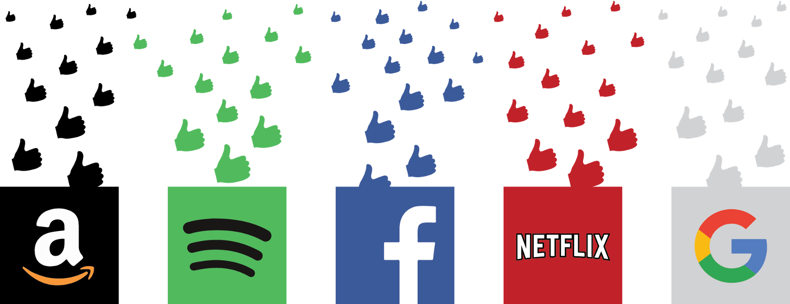
Recommender System

Slide 3
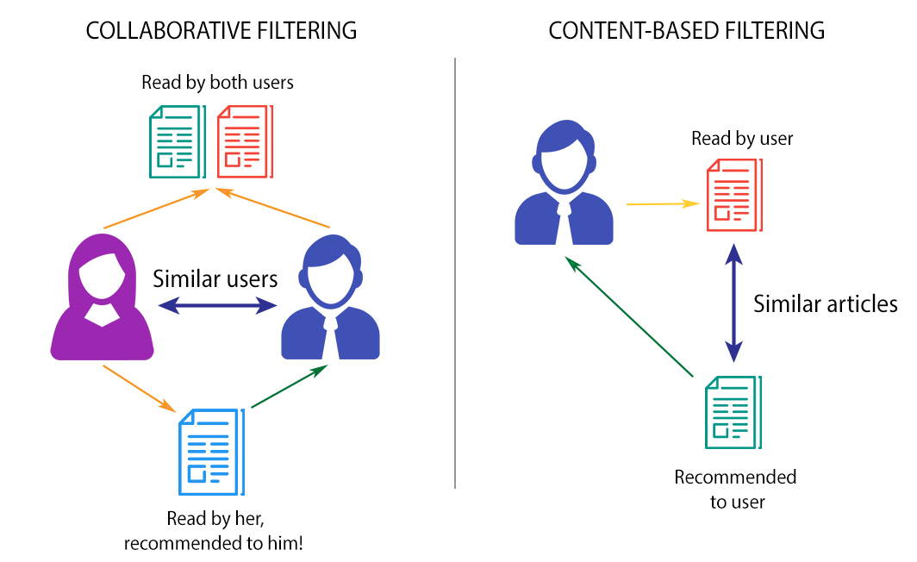

Common Types of Recommender Systems

Slide 4
Minimum Viable Product (MVP)
Machine Learning based Recommendation System
Use of movieLens Dataset :- 943 Users, 1682 Movies, 100,000 Ratings
Use of Matrix Factorization and Cosine Similarity
Web-App to view Recommendations

Slide 5
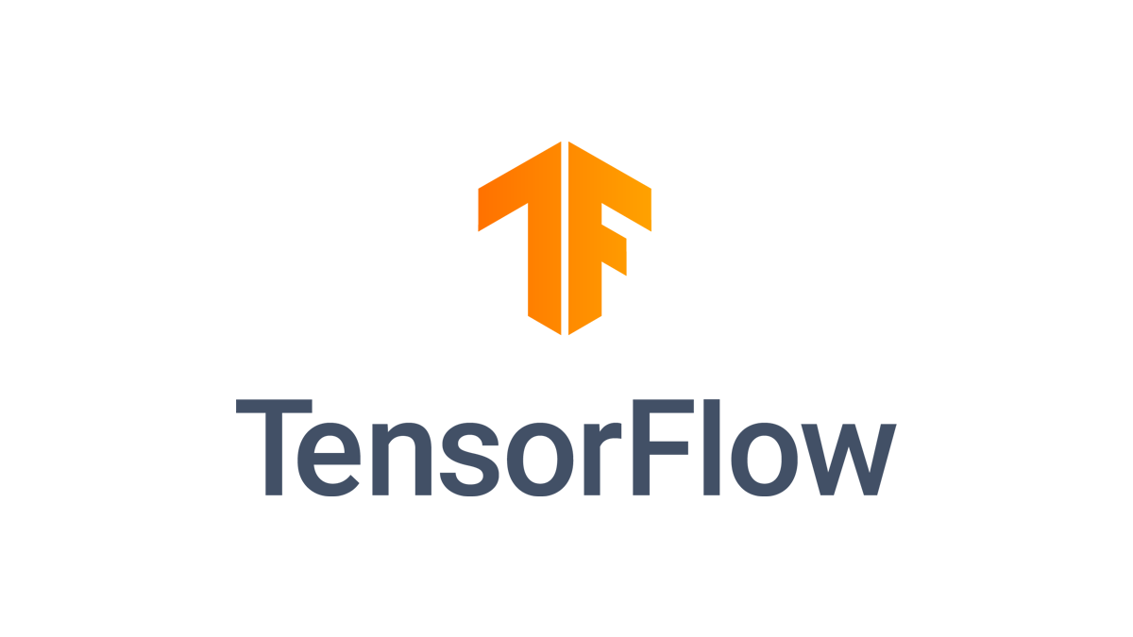


Development Environment
Tensorflow: Machine Learning Framework - Provides functions for machine learning.
Google Colab - A python notebook by Google to perform mainly machine learning/data science programs with the availability of free GPU, TPU.
Django - Web-Application Framework

Slide 6
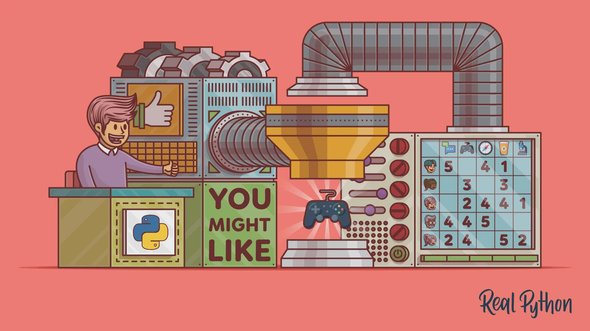
Matrix Factorization
Decomposition of Matrix
Dimensionality Reduction
Collaborative Filtering
Finds Laten(hidden) features
Predicts Missing values

Slide 7
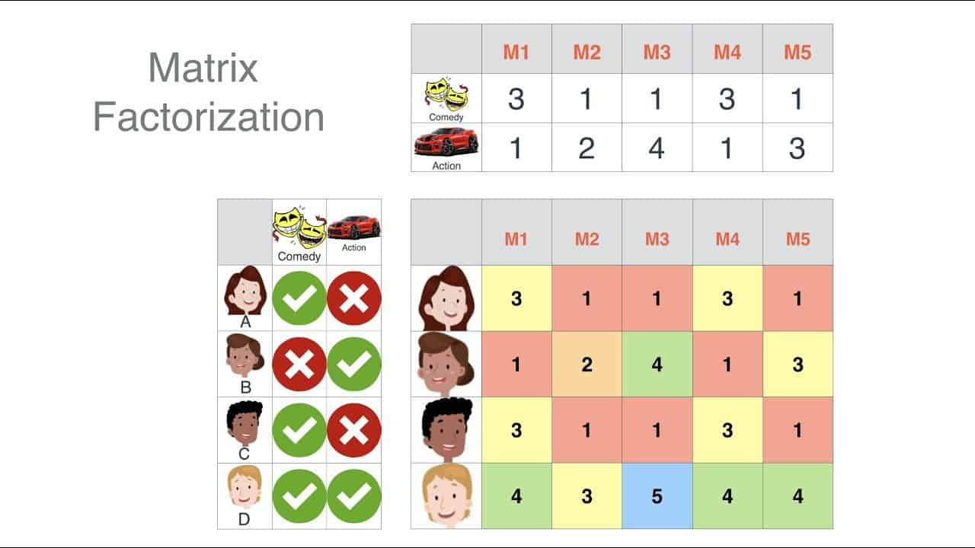
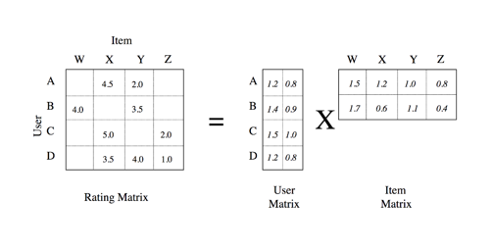
Working of Matrix Factorization

Slide 8
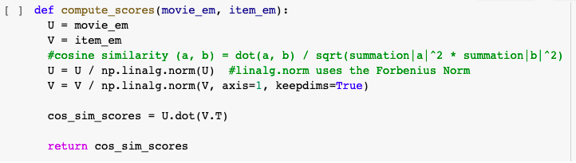
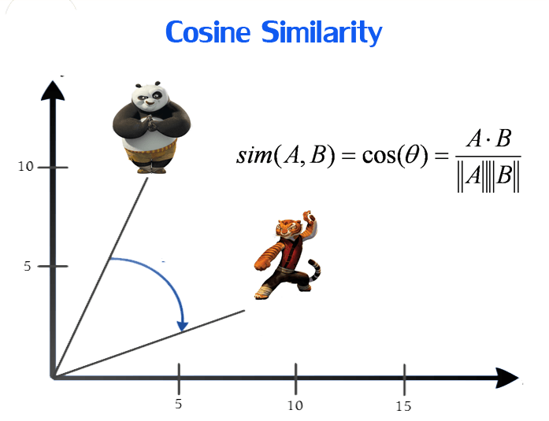
Cosine Similarity
Measures Similarity between two vectors
Finds similar movies for recommendation

Slide 9
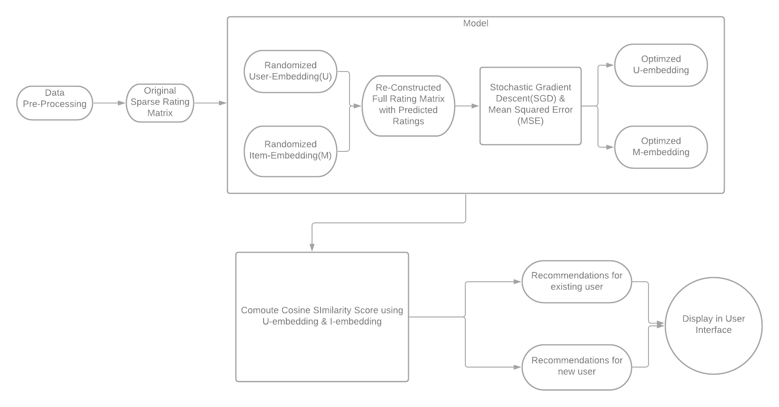
Architecture

Slide 10
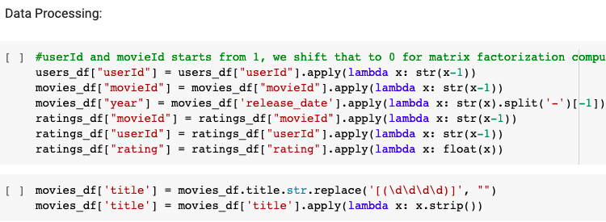
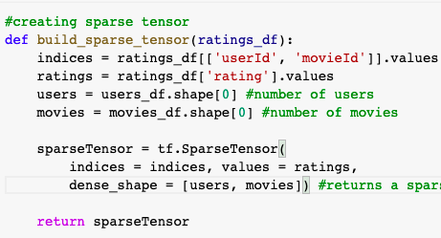
Breakdown
Data Pre-Processing
Pandas used for creating Dataframes, and pre-processing
SparseTensor is created using tensorflow function to get only non 0 rating values for Optimization

Slide 11
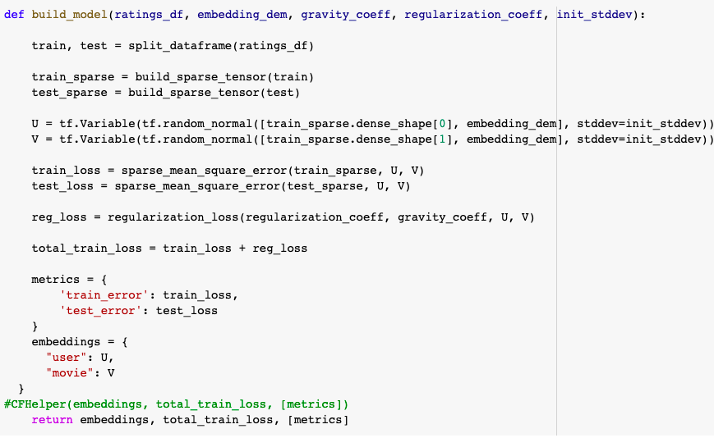
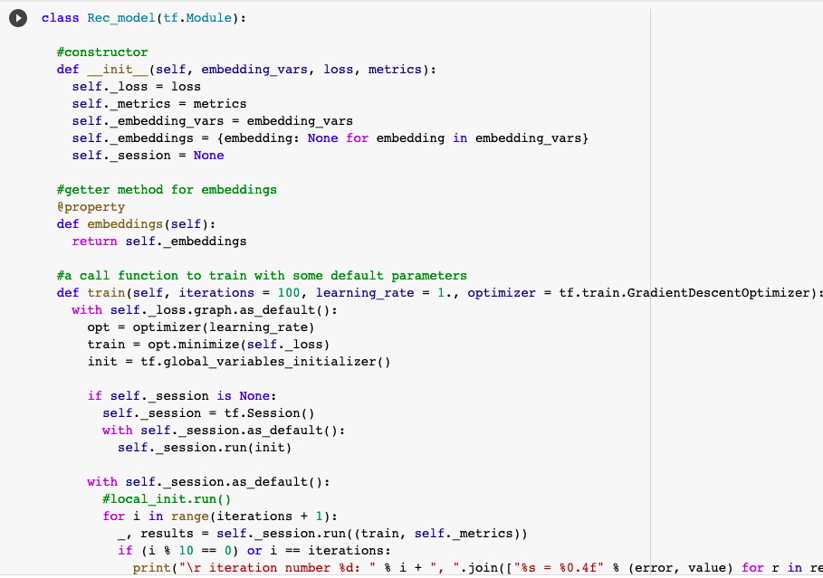
Model
Initialize -> User Embedding (U) & Item Embedding (V)
Matrix Multiply ->Rating Matrix.
Mean Square Error (MSE) -> Loss value of predicted rating
Feed Embeddings and Loss value to Model Helper -> loss optimized

Slide 12
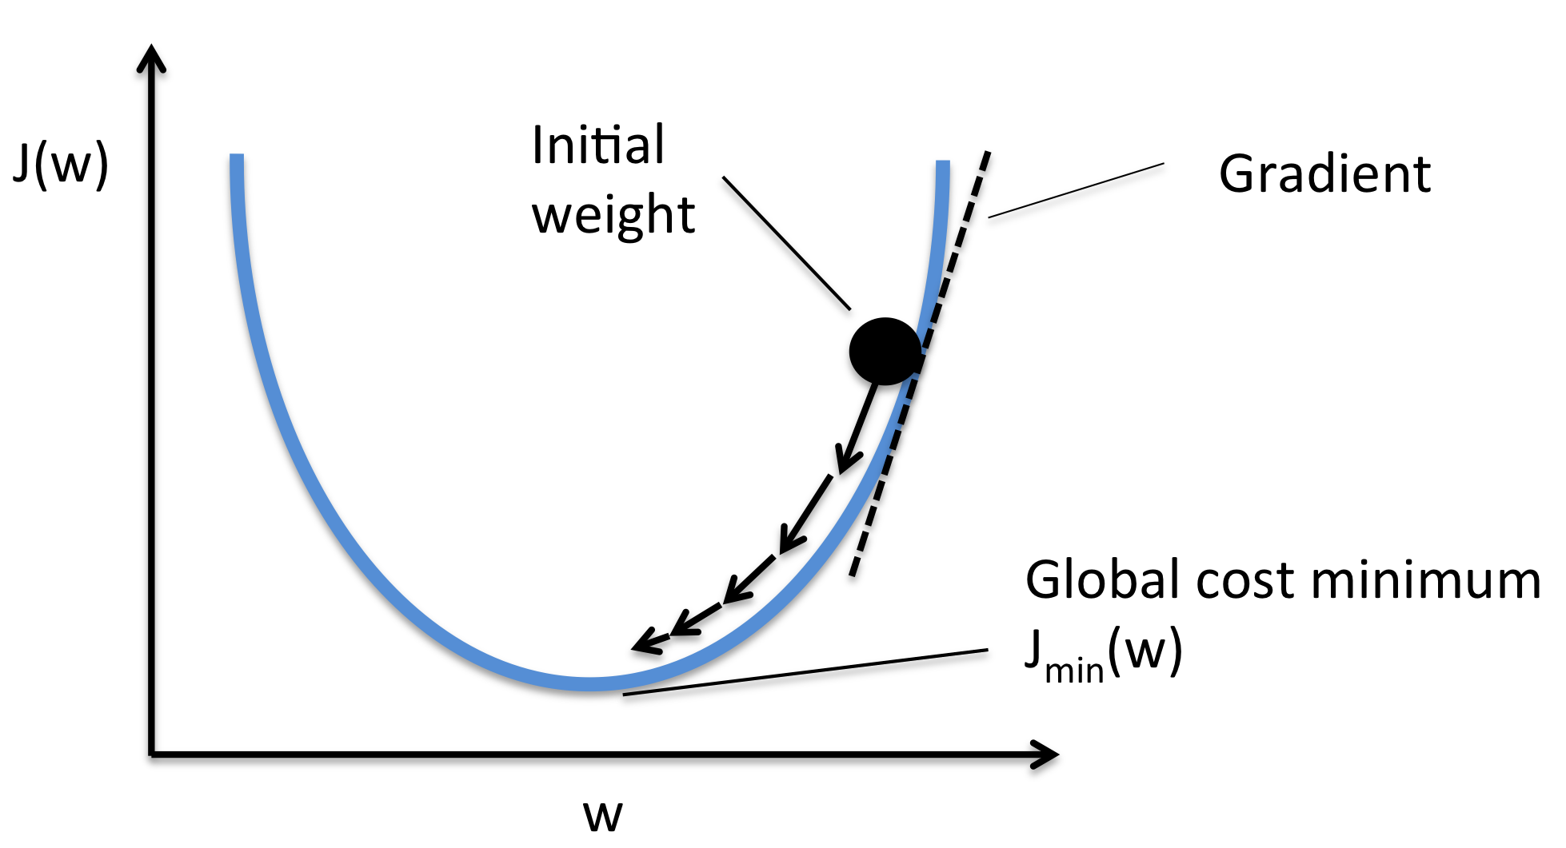
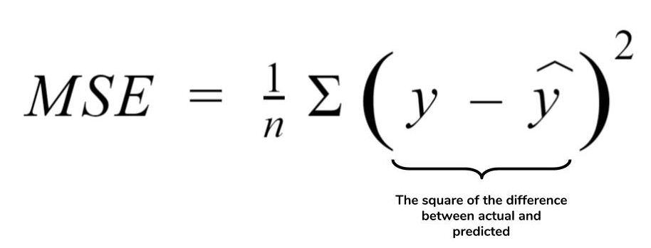
Stochastic Gradient Descent (SGD)
Common Optimization Function
Gradient -> slope
Gradient descent -> find lowest point
minimize the mean squared error (MSE)

Slide 13
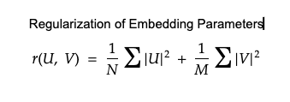
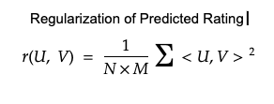
Regularization
Used to prevent Overfitting
Form of Regression
Brings coefficients close to 0
L2 Regularization - U and V
L2 Regularization - Predicted rating

Slide 14
Model (Continued)
Feed Embeddings and Loss value to Model Helper
Model returns optimized embeddings
Cosine Similarity
Compute cosine score
Uses User-embedding and Item-embedding

Slide 15
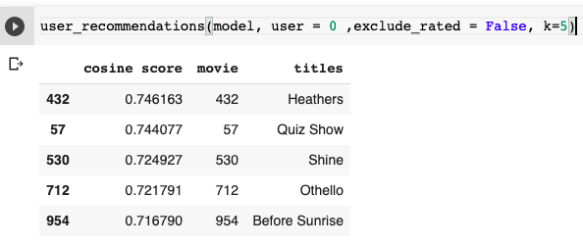
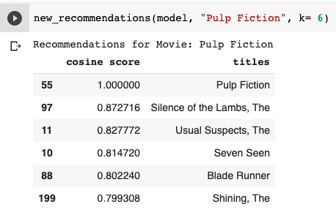
Generate Recommendations
Existing Users
Retrieve User-embedding of User
Compute Cosine Score
Recommend Top-N movies
New User
Prompt User to select Movie
Retrieve Item-embedding row of Movie
Compute Cosine Score
Recommend Top-N movies

Slide 16
Testing the Quality of Recommendations
Recommendations are made for an Existing User without Excluding previously Rated Movies
If previously Rated (high rating) are recommended, then the Recommendations are good.

Slide 17
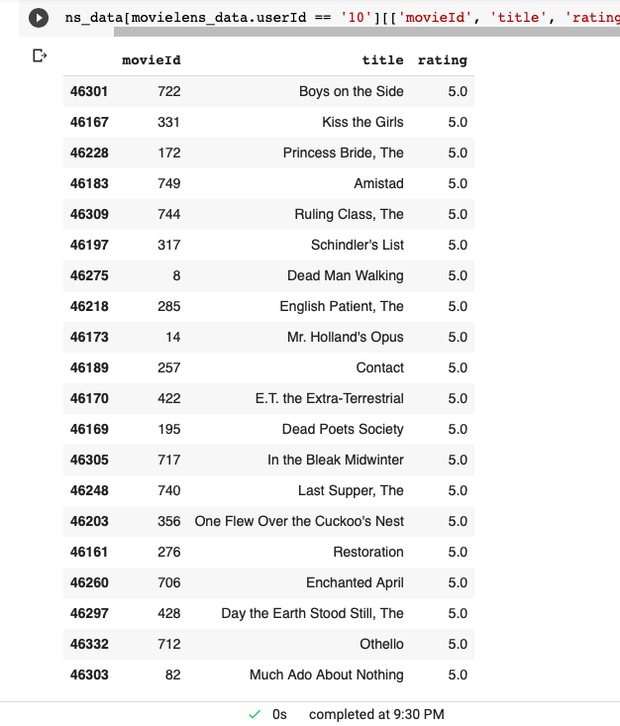
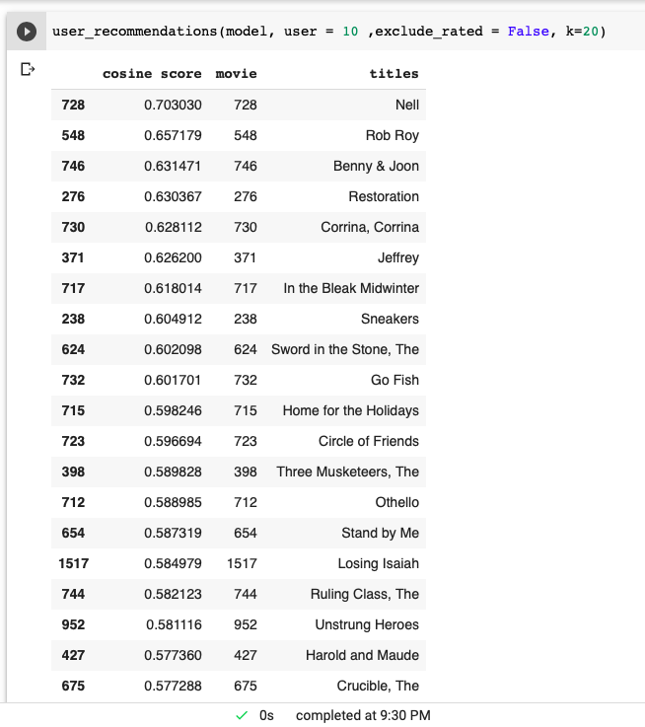

Slide 18
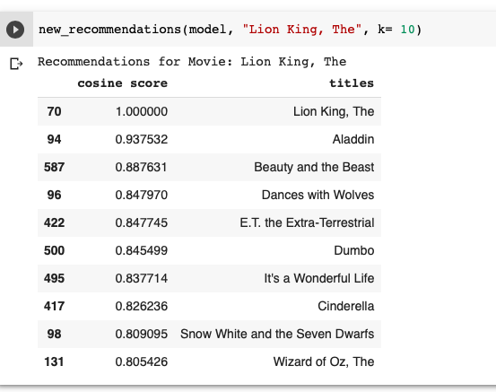

Slide 19
Why Matrix Factorization
Matrix Factorization is a Collaborative Filtering method which is commonly used for Recommendation System and such methods are used by sites like Amazon.
A matrix factorization technique called SVD(Singular Value Decomposition) was used to win the Netflix Prize of $1M in Sep 21, 2009.
I wanted to incorporate Machine Learning factor in recommendation system and not just use conventional item-item similarity or user-user similarity filtering

Slide 20

DEMONSTRATION

Slide 21
Future Improvements
Build a Model with SVD, and Neural Network
Improve the Web-Application

Slide 22
THE END
Questions?

